Slide 1
Come in quietly.
Take out your chromebook (Closed).
Take out paper, pen or pencil
8/24/16
Learning Target:
I will be able to explain the push-pull factors of the English coming to America.
I will be able to explain the push-pull factors of the Spanish coming to America.
I will be able to explain the push-pull factors of the French coming to America.

Slide 2
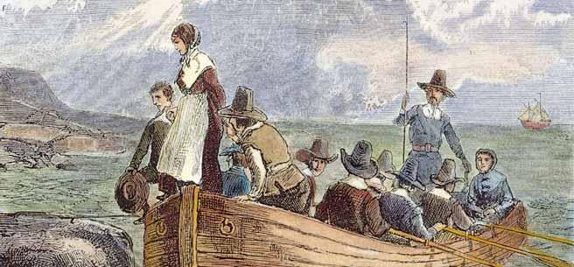
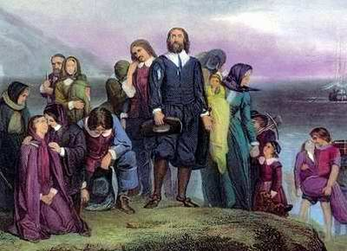
Immigration in North America!
8/24/16
Objective
Obj: Identify and describe the original push/pull factors that led countries and people to immigrate to North America.
Standard 8.1: Students understand the major events preceding the founding of the nation and relate their significance to the development of American constitutional democracy.
CCSS.ELA-LITERACY RH.8.4:Determine the meaning of words and phrases as they are used in a text, including vocabulary specific to domains related to history/social studies.

Slide 3

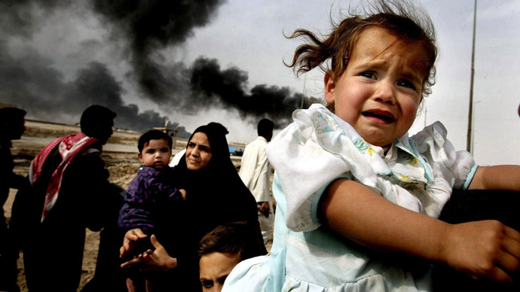
Examples/Non-examples
Push Factor - are those things that encourage a person to leave their home.
Pull Factor - something that attracts people to go and live in a particular place.
Concept
2.
Number __ is/is not an example of push/pull factor because ___ because ___.

Slide 4
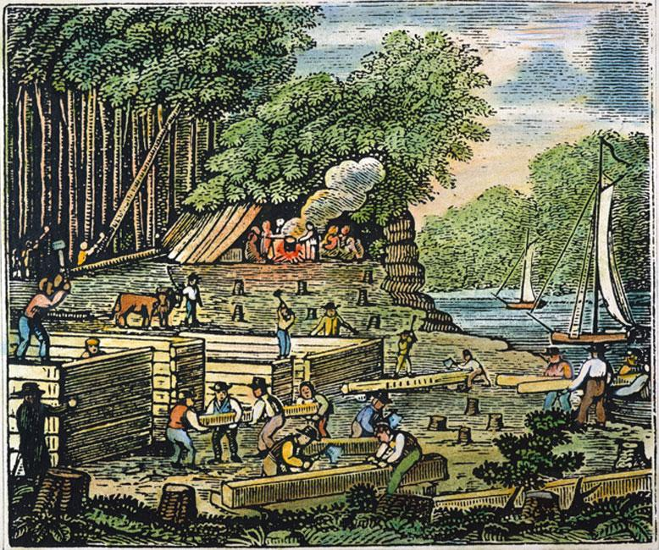
Prior Knowledge
You already know 3 types of immigrants and the meaning of push/pull factors in immigration.
Use the explanations and examples discussed last week to help you answer this question.
Why might the original immigrants have come to North America?
“The original immigrants might have come to North America because ____”

Slide 5
Relevance
Relevance
The people who originally immigrated to North America came for many reasons. Together they created the foundation upon which the United States was born.
So, why is it important for us to understand the push/pull factors that led countries and people to immigrate to North America?
Partner A tell Partner B “It’s important to understand the push/pull factors that led countries and people to immigrate to North America because ________”.
Partner B tell Partner A “I (agree or disagree) it’s important to understand the push/pull factors because _______”.

Slide 6
Relevance
Relevance
The people who originally immigrated to North America came for many reasons. Together they created the foundation upon which the United States was born.
So, why is it important for us to understand the push/pull factors that led countries and people to immigrate to North America?
It’s important because their push/pull factors affected their decisions, their interactions with each other and ultimately the type of country the United States would become.

Slide 7
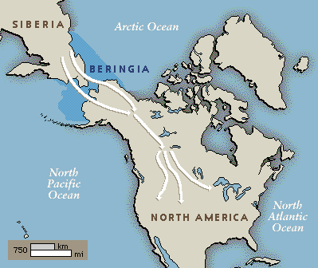
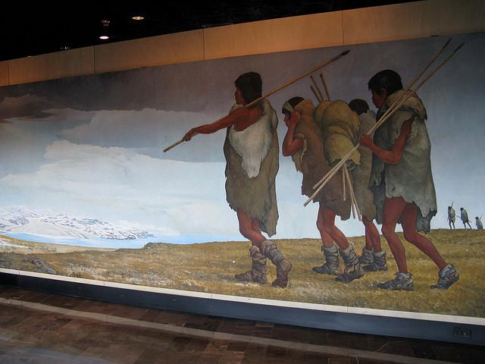
Earliest Immigration to America
Concept
The United States experienced major waves of immigration during the colonial era.
From its earliest days, America has been a nation of immigrants starting with its original inhabitants, who crossed a land bridge connecting Asia and North America tens of thousands of years ago.

Slide 8

Earliest Immigration to America
Concept

Slide 9
Earliest Immigration to America
Concept
The United States experienced major waves of immigration during the colonial era.
From its earliest days, America has been a nation of immigrants starting with its original inhabitants, who crossed the land bridge connecting Asia and North America tens of thousands of years ago.
Why did the original inhabitants cross the land bridge?
Partner A tell Partner B “The original inhabitants crossed the land bridge because ________”.
Partner B tell Partner A “I (agree or disagree) the original inhabitants crossed the land bridge because _______”.

Slide 10
Claiming land in North America
Concept
Spain, France, Britain, and the Netherlands (Dutch) all claimed land in North America in the 1600s.
Why did these countries want to claim land in North America?
Open to Google Classroom

Slide 11
Push/Pull Factors
Watch the video.
Research on Google.
Complete the Graphic Organizer.
Skill - I Do
Directions: Use your textbook and Google Search to find the push pull factors that led each country to send immigrants to North America in the 1600's.
Push/Pull Factors For Original European Immigration to North America
Which country did they immigrate from? | Push Factors | Pull Factors | Where did these immigrants settle?
Competition
Gold to keep power.
Spread Catholicism
Gold, Silver, Riches
Current day Mexico, Florida and Western half of US
Spain

Slide 12
Push/Pull Factors
Watch the video.
Research on Google.
Complete the Graphic Organizer.
Skill - We Do
Directions: Use your textbook and Google Search to find the push pull factors that led each country to send immigrants to North America in the 1600's.
Push/Pull Factors For Original European Immigration to North America
Which country did they immigrate from? | Push Factors | Pull Factors | Where did these immigrants settle?
Competition
Gold to keep power.
Spread Catholicism
Gold, Silver, Riches
Spain
Current day Mexico, Florida and Western half of US
England
Not practice their religion.
Debt - owe money
No work
Start new life
Get Riches
New religion
East Coast of U.S.

Slide 13
Identifying Push/Pull Factors for Immigration to North America
Watch the video.
Research on Google.
Complete the Graphic Organizer.
Skill - You Do
Independent Practice
Directions: Use your textbook and Google Search to find the push pull factors that led each country to send immigrants to North America in the 1600's.
Push/Pull Factors For Original European Immigration to North America
Which country did they immigrate from? | Push Factors | Pull Factors | Where did these immigrants settle?
Spain | Competition Gold to keep power. Spread Catholicism | Gold, Silver, Riches | Current day Mexico, Florida and Western half of US
England | Not practice their religion. Debt - owe money No work | Start new life Get Riches New religion | East Coast of U.S.
France
Netherlands (Dutch)

Slide 14
Closure
Closure
What countries claimed land and sent immigrants to North America?
Describe some of the push/pull factors that led immigrants from these countries to come to North America.

